Slide 1
React. Conditional rendering. Children types. Array as children, Function as children
By Iryna Susiak

Slide 2
React Patterns
Stateless function
JSX Spread Attributes
Destructuring Arguments
Conditional Rendering
Children Types
Array as children
Function as children
Render callback
Children pass-through
Proxy component
Style component
Event switch
Layout component
Container component
Higher-order component

Slide 3
Conditional Rendering
In React, you can create distinct components that encapsulate behavior you need. Then, you can render only some of them, depending on the state of your application.
Conditional rendering in React works the same way conditions work in JavaScript. Use JavaScript operators like if or the conditional operator to create elements representing the current state, and let React update the UI to match them.
We can conditionally render items in React components by using regular if or switch statements, or we can use the ternary operator for conditionals that have two cases.

Slide 4
If/else
You can't use if/else statements inside JSX. This is because JSX is just syntactic sugar for function calls and object construction.
This means that if statements don't fit in. Take this example:
// This JSX: <div id={if (condition) { 'msg' }}>Hello World!</div>
// Is transformed to this JS: React.createElement("div", {id: if (condition) { 'msg' }}, "Hello World!");
So conditional (ternary) operator and short-circuit evaluation are your friends.

Slide 5
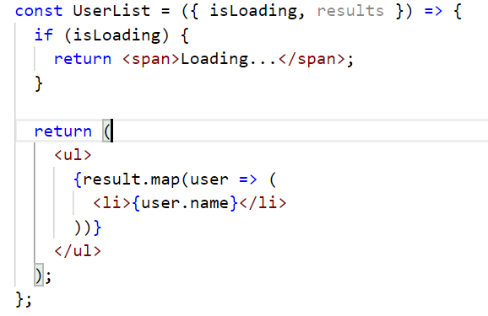
If
IF is the most basic approach of all and probably the one you will mostly see, but it is restricted to the total block of the component. You use an IF with your condition and return the element to be rendered. Observe the example below:
Note that we DO NOT use ELSE since there is no need as we use the return within the first IF.
There is nothing wrong with the above example, on the contrary, the code is simple and readable.
However, this approach is restricted to rendering a whole block and in many cases, we can not use it.

Slide 6
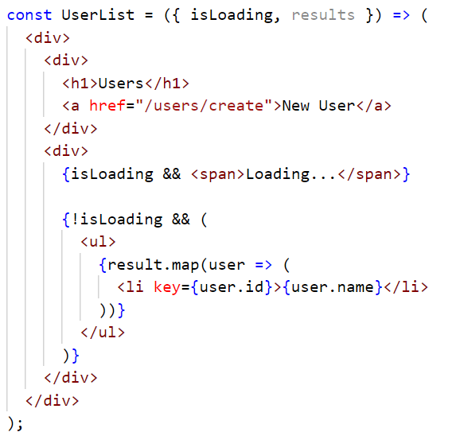
If/else - inline
As in the example above, we can use braces ({}) to insert a JS expression inside JSX.
React will get the result of each expression and will render on the screen.
It works because in JavaScript, true && expression always evaluates to expression, and false && expression always evaluates to false.
Therefore, if the condition is true, the element right after && will appear in the output. If it is false, React will ignore and skip it.

Slide 7
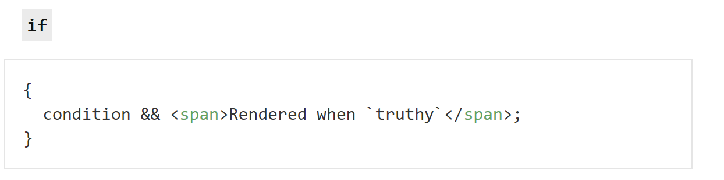
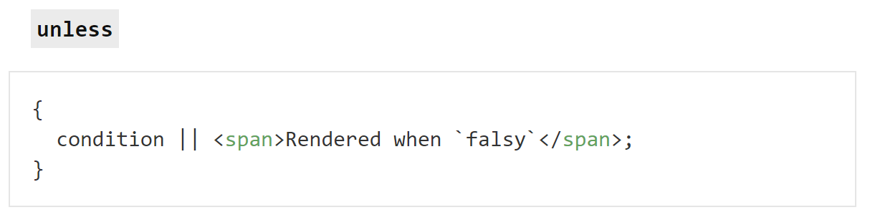
If/else inline

Slide 8
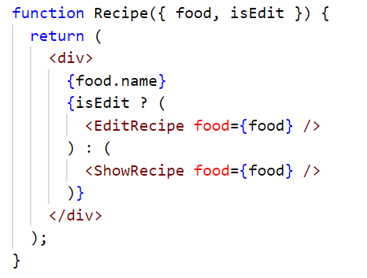
Ternary
Instead of using an if/else block, we can use the ternary conditional operator
The operator is wrapped in curly braces, and the expressions can contain JSX, optionally wrapped in parentheses to improve readability. It can also be applied in different parts of the component.

Slide 9
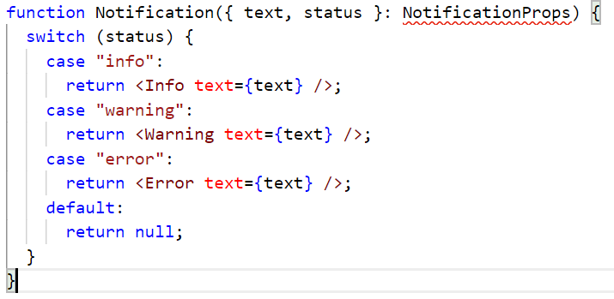
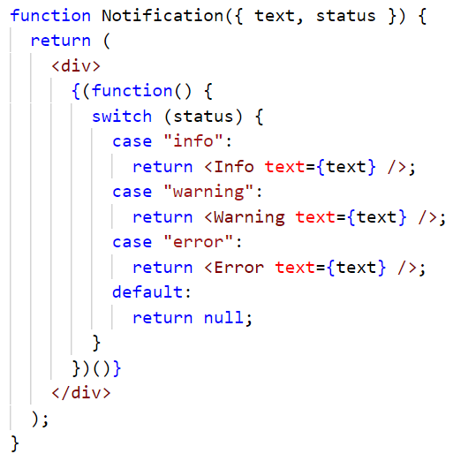
Switch
Now there might be cases where you have multiple conditional renderings. You can use a switch case operator for multiple conditional renderings.
A switch case is a good start for multiple conditional renderings. But switch case cannot be used within JSX; can it? Actually it's possible with a conditional rendering function which is self invoking:

Slide 10
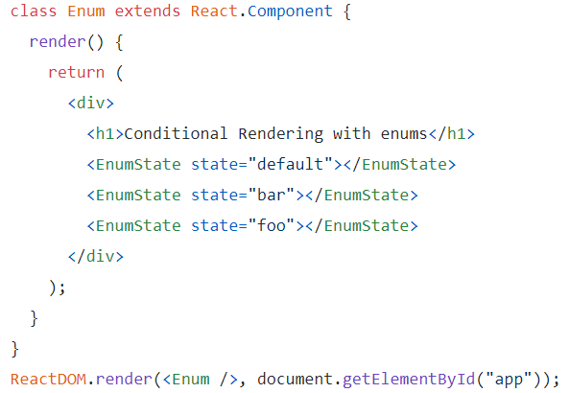
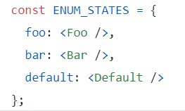

Enums
In JavaScript, an object can be used as an enum when it is used as a map of key-value pairs.
Let’s now create a function that will take state as a parameter and return components based on “state”.
Let’s create an Enum component, which will pass the values of “state” to the function “EnumState”.

Slide 11
Enums
Let’s create an Enum component, which will pass the values of “state” to the function “EnumState”.
That’s it! We have conditional rendering implemented smoothly with enums.
As we saw, the enum approach is more readable in comparison to the switch case statement. Objects as enum open up a plethora of options to have multiple conditional renderings.

Slide 12
Cheatsheet
if
most basic conditional rendering
use to opt-out early from a rendering
cannot be used within return statement and JSX (except self invoking function)
if-else
use it rarely, because it's verbose
instead, use ternary operator or logical && operator
cannot be used inside return statement and JSX (except self invoking function)
ternary operator
use it instead of an if-else statement
it can be used within JSX and return statement
logical && operator
use it when one side of the ternary operation would return null
it can be used inside JSX and return statement
switch case
avoid using it, because it's too verbose
cannot be used within JSX and return (except self invoking function)
instead use enums
enums
use it for conditional rendering based on multiple states
perfect to map more than one condition

Slide 13
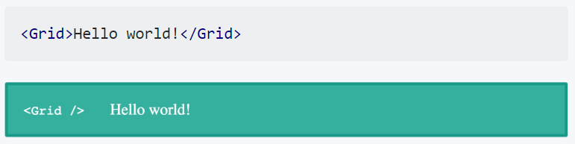
Children types
Children in React don’t have to be components, they can be anything.
For example, we can pass our <Grid /> component from above some text as children and it’ll work perfectly fine:

Slide 14
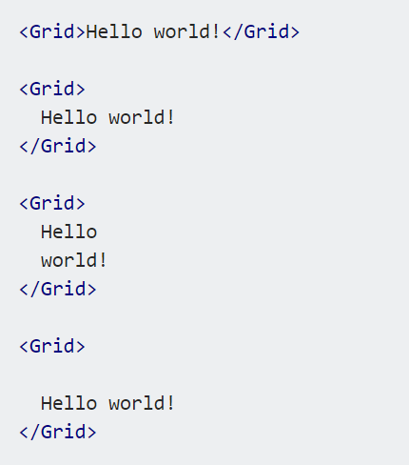
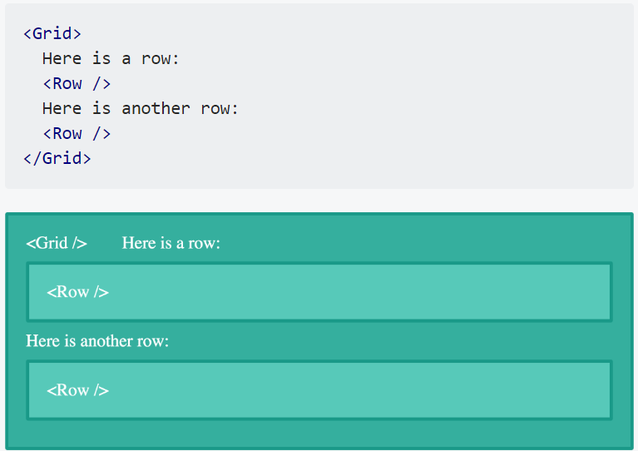
Children types
JSX will automatically remove whitespace on the beginning and ending of a line as well as blank lines. It also condenses blank lines in the middle of string literals into one space. This means all of these examples will render the same thing:
You can also mix and match multiple types of children perfectly fine:

Slide 15
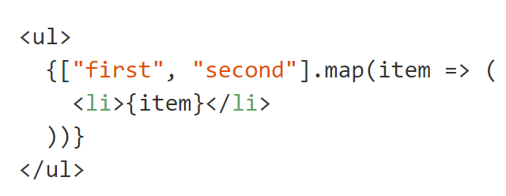

Array as children
Providing an array as children is a very common.
It's how lists are drawn in React.
We use map() to create an array of React Elements for every value in the array.
That's equivalent to providing a literal array.

Slide 16
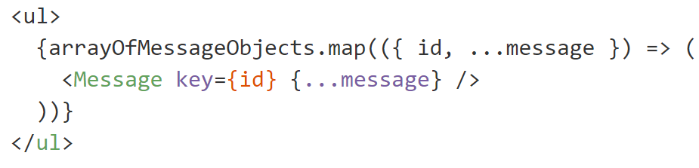
Array as children
This pattern can be combined with destructuring, JSX Spread Attributes, and other components, for some serious terseness.

Slide 17

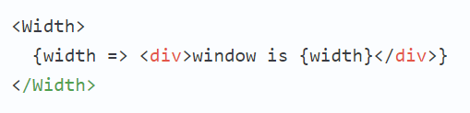

Function as a child
“Function as Child Component”s are components that receive a function as their child. The pattern is simply implemented and enforced thanks to React’s property types.
Here's a component that uses a render callback. It's not useful, but it's an easy illustration to start with
The component calls children as a function, with some number of arguments. Here, it's the number 500. To use this component, we give it a function as children.
We get this output.

Slide 18
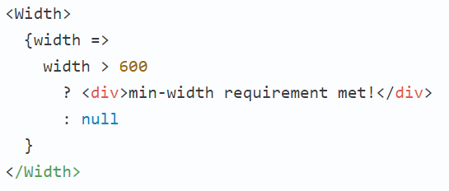
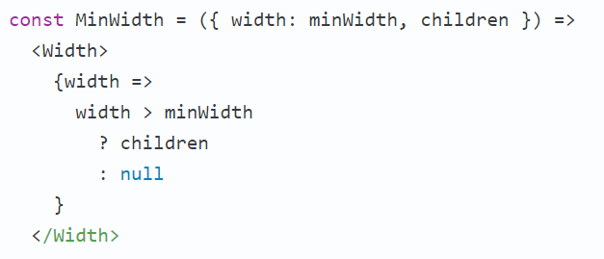
Function as a child
With this setup, we can use this width to make rendering decisions.
If we plan to use this condition a lot, we can define another components to encapsulate the reused logic.

Slide 19
Useful links
https://uk.reactjs.org/docs/conditional-rendering.html
https://www.robinwieruch.de/conditional-rendering-react
https://blog.logrocket.com/conditional-rendering-in-react-c6b0e5af381e/
https://devhints.io/react
https://mxstbr.blog/2017/02/react-children-deepdive/#function-as-a-child

Slide 20


